Slide 1
Semantic Annotation service
A first prototype for B2Note
Yann Le Franc, PhD
e-Science Data Factory, France
User Forum, Rome
Feb 3-4, 2016

Slide 2
What do we mean by annotation?
By definition, an annotation is “a note added to a text, book, drawing, etc., as a comment or an explanation” (from Merriam Webster).
In our context, it is an assertion we want to make about a digital resource i.e. a text file, an image, a recording, a movie,... .

Slide 3
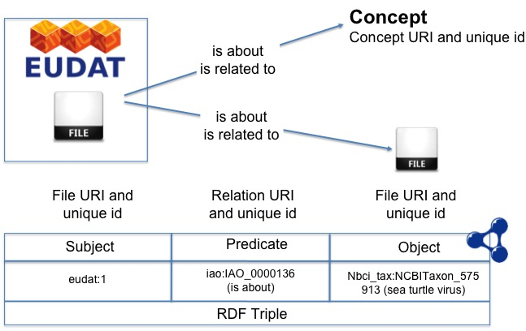
Semantic Annotation: General Principles

Slide 4
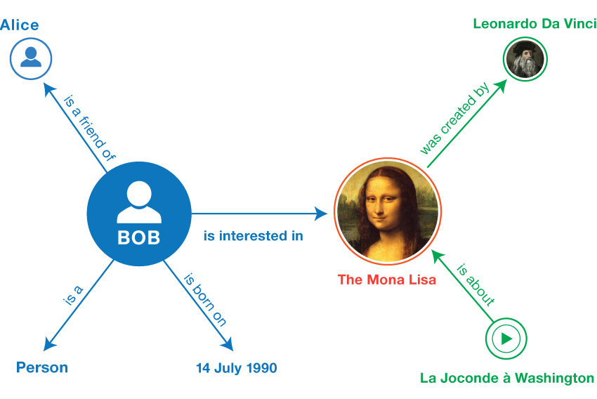
In the end, it’s a way to create a GRAPH!!
From https://www.w3.org/TR/2014/NOTE-rdf11-primer-20140225/

Slide 5

Now we need to store it…
Triple Store
Subject | Predicate | Object
Alice | is a friend of | Bob
Bob | Is interested in | The Mona Lisa
Bob | Is a | Person
Bob | Is born | 14 July 1990
The Mona Lisa | Was created by | Leonardo Da Vinci
La Joconde in Washington | Is about | The Mona Lisa
SPARQL endpoint
SPARQL Queries

Slide 6





Our Vision
Semantic Web/Linked Services and Data infrastructure
Extend data object description
Link data objects within the EUDAT CDI and with external resources
Make data object description interoperable and discoverable

Slide 7
The “use-cases”
Manual annotations of data elements: semantic tagging and file linking
Semi-automatic annotations of data element content: related with LTER Data Pilot
Data curation: curation status tags
Create aggregated datasets from multi-scale or multi-domain datasets.

Slide 8
Manual annotation: the design
The User interface: Widget/iframe approach
  easy integration with the different EUDAT services
  Integrate with community web UI
The User interface: easy for the user
  auto-completion with terms from domain specific controlled vocabularies
The Backend
  Store triples as JSON in MongoDB backend
  Triples published on triple store: SPARQL queries
The data model
  RDF model: triple + minimal provenance information

Slide 9









The architecture
User Interface
Local Ontology Index
External Ontology/ Vocabulary repository
Auto-completion
function
JSON
Annotation functions
JSON
JSON
Publish
RDF, Turtle, N-Triple,…
SPARQL
Store

Slide 10
The prototype
http://b2note.bsc.es/devel

Slide 11
The prototype

Slide 12
The prototype

Slide 13
The prototype

Slide 14
Test integration with B2SHARE
https://86.50.168.182

Slide 15
Test integration with B2SHARE

Slide 16
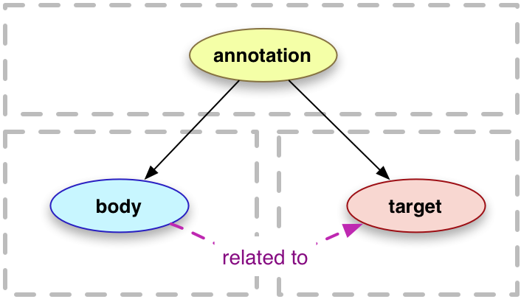
Next step
Use Open Annotation data format (http://www.openannotation.org/spec/core/ )
Add a RESTful API to access annotation services
Develop search functionalities and interface for annotation
Publish data through SPARQL endpoint
Use Linked Data Platform standard,…

Slide 17
Our aims
Improve prototype to release a pilot service in the upcoming 6 months
Get more use-cases to extend the service functionalities
Integrate with B2FIND

Slide 18


The team
Antoine Brémaud, PhD
e-Science Data Factory
Pablo Ródenas
BSC
Thanks to
Emanuel Dima (B2Share)
The Semantic Working Group
The EUropean Ontology Network
http://www.eudat.eu/join-euon

