Slide 1
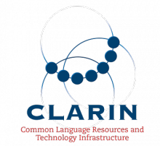
CLARIN & EUDAT Collaboration
Clarin.eu

Slide 2
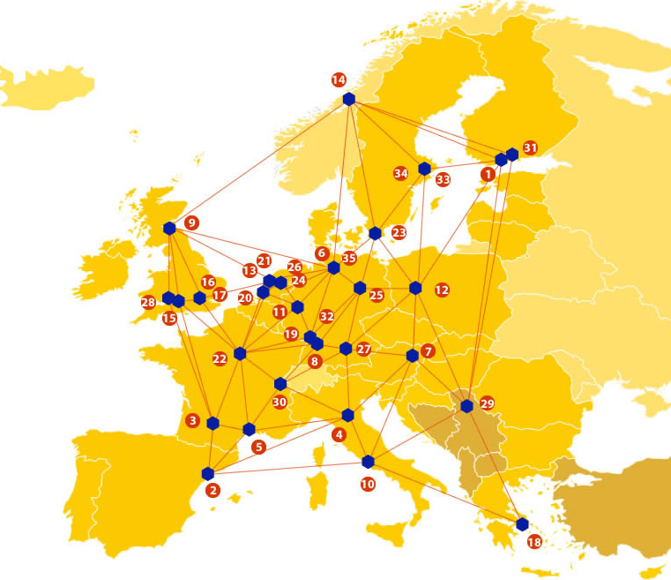

EUDAT: A truly pan-European Infrastructure
EUDAT offers common data services to both research communities and individuals through a network of 35 European organisations.
EUDAT wants to enable European researchers from any discipline to preserve, find, access, and process data in a trusted environment, as part of a Collaborative Data Infrastructure.
European infrastructures
Technology Providers
Research Communities

Slide 3

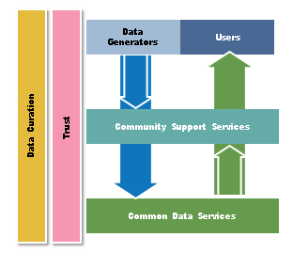
EUDAT Vision & Mission
Vision: Data is shared and preserved across borders and disciplines thereby enhancing the value and quality of research at large.
Mission: To enable data stewardship within and between European Research Communities through a Collaborative Data Infrastructure, a common model and service infrastructure for managing data spanning all European research data centres and community data repositories.

Slide 4
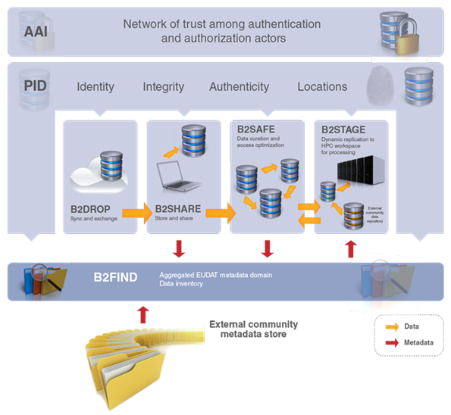










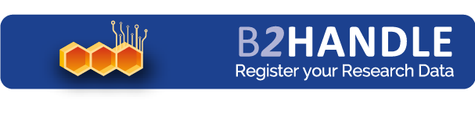



B2 Service Suite
Covering both access and deposit, from informal data sharing to long-term archiving, and addressing identification, discoverability and computability of both long-tail and big data, EUDAT services seek to address the full lifecycle of research data
https://www.eudat.eu/services
Notes:
B2FIND
stores metadata as well through other EUDAT services such as B2SHARE to provide access to data object within the EUDAT CDI
is used in inter-service use cases, e.g. to select links to data to be transferred to HPC platforms through B2STAGE

Slide 5
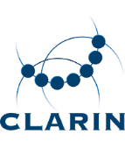





Building solutions with the communities
EUDAT services (B2 Service Suite) are designed, built and implemented together with user communites.
Common Language Resources and Technology Infrastructure (CLARIN)
European Network for Earth System Modelling (ENES)
Distributed infrastructure for life-science information (ELIXIR)
European Plate Observing System (EPOS) - Solid Earth sciences Research Infrastructure
Integrated Carbon Observation System (ICOS) to quantify & understand greenhouse gas balance
Long-Term Ecosystem Research (LTER) in Europe

Slide 6


CLARIN & EUDAT Service Uptake Plan
Sharing Research Data (B2SHARE)
      Uses the repository for shareable digital objects (B2SHARE) and harvests the community metadata for inclusion into the Virtual Language Observatory.
Data replication and long term preservation (B2SAFE)
      Data replication & long term preservation of the language data they are hosting & will extend the deployment throughout many CLARIN centres

Slide 7

Synchronising & Exchanging Research Data (B2DROP)
CLARIN & EUDAT Service Uptake Plan
      use the secure and trusted cloud service to integrate their own workspaces into EUDAT. Thus allowing data retrieval and storage from the CLARIN community services.

Slide 8
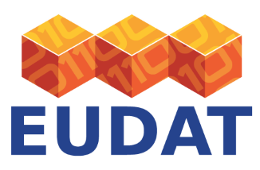
For More Information
CLARIN
For more info on CLARIN - clarin.eu
For more info on EUDAT – eudat.eu
EUDAT
Web – eudat.eu
Twitter - @EUDAT_EU

