Slide 1

The use of the EUDAT repository to store clinical trials in a secure and compliant way

Slide 2
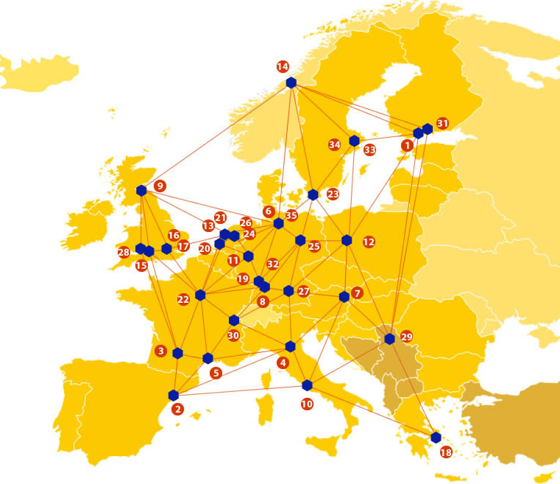

EUDAT: A truly pan-European Infrastructure
EUDAT offers common data services to both research communities and individuals through a network of 35 European organisations.
EUDAT wants to enable European researchers from any discipline to preserve, find, access, and process data in a trusted environment, as part of a Collaborative Data Infrastructure.
European infrastructures
Technology Providers
Research Communities

Slide 3

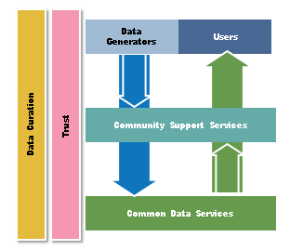
EUDAT Vision & Mission
Vision: Data is shared and preserved across borders and disciplines thereby enhancing the value and quality of research at large
Mission: To enable data stewardship within and between European Research Communities through a Collaborative Data Infrastructure, a common model and service infrastructure for managing data spanning all European research data centres and community data repositories

Slide 4
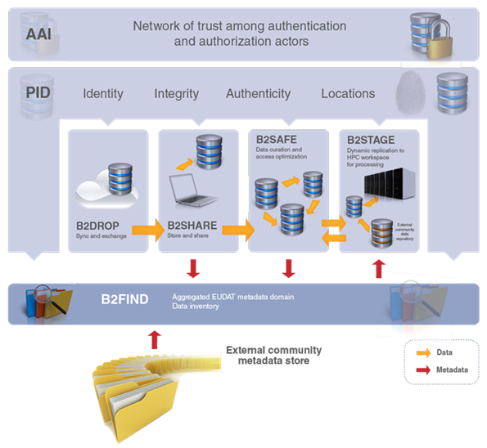














B2 Service Suite
Covering both access and deposit, from informal data sharing to long-term archiving, and addressing identification, discoverability and computability of both long-tail and big data, EUDAT services seek to address the full lifecycle of research data
https://www.eudat.eu/services
Notes:
B2FIND
stores metadata as well through other EUDAT services such as B2SHARE to provide access to data object within the EUDAT CDI
is used in inter-service use cases, e.g. to select links to data to be transferred to HPC platforms through B2STAGE

Slide 5






Building solutions with the communities
EUDAT services (B2 Service Suite) are designed, built and implemented together with user communities.
Common Language Resources and Technology Infrastructure (CLARIN)
European Network for Earth System Modelling (ENES)
Distributed infrastructure for life-science information (ELIXIR)
European Plate Observing System (EPOS) - Solid Earth sciences Research Infrastructure
Integrated Carbon Observation System (ICOS) to quantify & understand greenhouse gas balance
Long-Term Ecosystem Research (LTER) in Europe

Slide 6

The Challenges
Challenges
Gap in the translation of basic scientific discoveries into clinical trials and medical practice
Clinical trials are too inefficient
Clinical source data not available for independent, secondary analysis and meta-analysis
Potential consequences without a solution
Continuing existence of isolated and inaccessible silos and archives with clinical trials data
Clinical trials are not being optimised, have to be terminated prematurely, are conducted redundantly

Slide 7
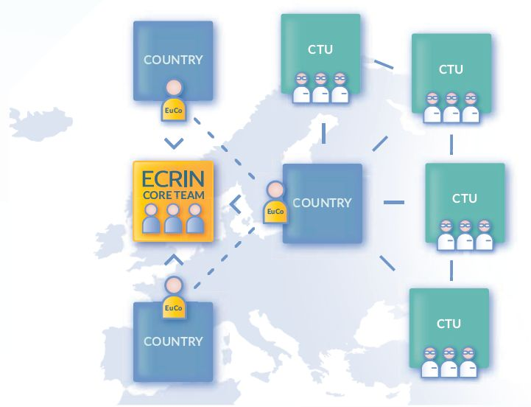
The Pilot Proponent
The European Clinical Research Infrastructure Network (ECRIN) is a not-for-profit international organisation that supports the conduct of multinational clinical trials in Europe
ECRIN operates as a network of national clinical trials networks consisting of Clinical Trial Units (CTU)
As of 2013, ECRIN has the legal status of a European Research Infrastructure Consortium (ERIC)
ECRIN supports the transparency of clinical trials
Transparency involves the registration of clinical trials and publication of results irrespective of the trial outcome
For full transparency patient-level data should be accessible, enabling reanalysis, secondary analysis, group analysis etc. See: http://www.ecrin.org/knowledge-about-clinical-trials/transparency
From: Supporting Clinical Trials Across Borders. ECRIN, Paris, 2015

Slide 8
The reason behind the EUDAT pilot
Randomized clinical trials (RCTs) are an important step in bringing treatments from preclinical development to the patient
Breakthroughs in basic biomedical sciences and human genomics have provided an ample supply of information able to improve human health
Many clinical trials are registered an basic and summary data is provided
But clinical trials data is in general not accessible for secondary analysis and meta-analysis
What is missing is a repository for clinical trial data (raw data, anonymized) that can be the first step for the exchange of clinical trials data with other biomedical research databases, and analysis by independent researchers

Slide 9
Pilot: The use of the EUDAT repository to store clinical trials data
In this pilot we will evaluate if EUDAT services can be used to store and share clinical trials data
The EUDAT repository will be combined with EUDAT services for secure, GCP (Good Clinical Practice) compliant and transparent storage of clinical trials data
Long-term storage of data in B2SAFE
Sharing of the data archived in B2SAFE for secondary analysis and collaboration with B2SHARE
Clinical trials data is human health data and thus subject to special protection and curation
The clinical trials data will be de-identified and anonymised data
An authentication service (AAS) will manage the access rights for users
A PID service will refer users, digital objects and associated documents to each other
In addition, the linking of metadata is necessary for the searchability of clinical trials data objects

Slide 10
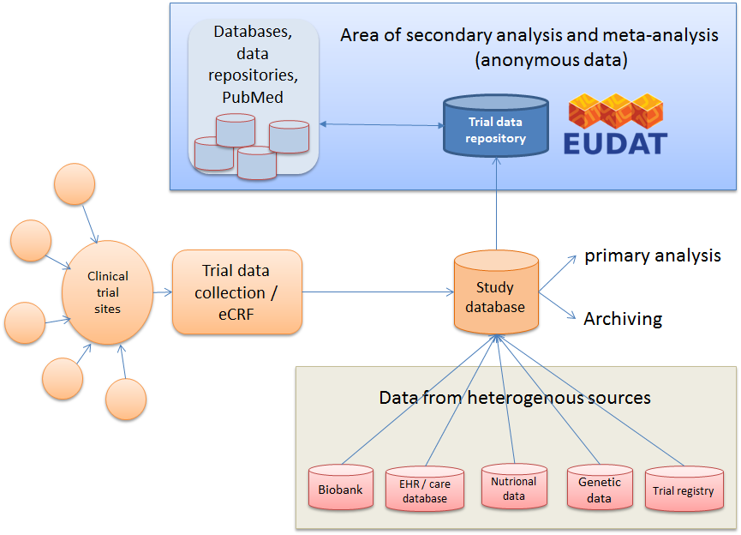
Position of the clinical trial data repository in the clinical trials workflow

Slide 11
EUDAT services uptake
The Pilot will rely on the following EUDAT services:
B2SAFE: long-term preservation of clinical trials data that allows the discovery and reuse of the data ingested
B2SHARE: to share the research data archived in B2SAFE and for secondary analysis and collaboration
B2FIND: act as aggregator integrated with B2SHARE metadata with the aim to enable discovering datasets of interests
B2ACCESS: enable access control and data security
B2HANDLE: employment of PID services for data objects

Slide 12

For additional information
http://www.eudat.eu/
Wolfgang Kuchinke
Heinrich-Heine University Düsseldorf, Germany
wolfgang.kuchinke@med.uni-duesseldorf.de

