Slide 1

DATA SPHINX & EUDAT Collaboration

Slide 2
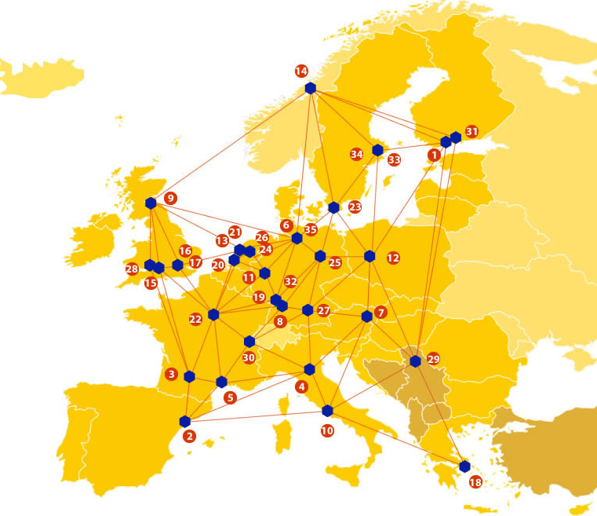

EUDAT: A truly pan-European Infrastructure
EUDAT offers common data services to both research communities and individuals through a network of 35 European organisations.
EUDAT wants to enable European researchers from any discipline to preserve, find, access, and process data in a trusted environment, as part of a Collaborative Data Infrastructure.
European infrastructures
Technology Providers
Research Communities

Slide 3

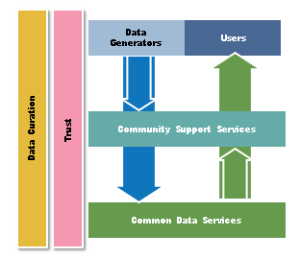
EUDAT Vision & Mission
Vision: Data is shared and preserved across borders and disciplines thereby enhancing the value and quality of research at large.
Mission: To enable data stewardship within and between European Research Communities through a Collaborative Data Infrastructure, a common model and service infrastructure for managing data spanning all European research data centres and community data repositories.

Slide 4
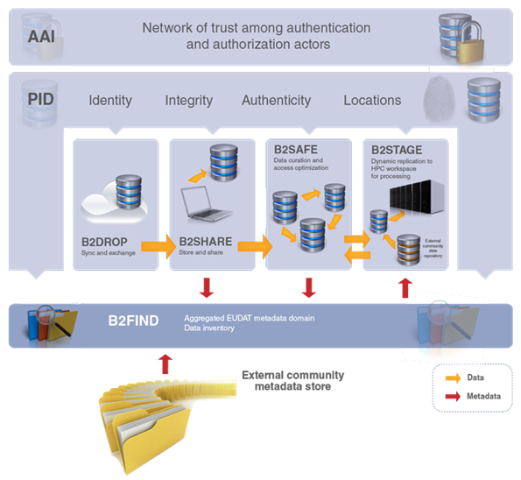














B2 Service Suite
Covering both access and deposit, from informal data sharing to long-term archiving, and addressing identification, discoverability and computability of both long-tail and big data, EUDAT services seek to address the full lifecycle of research data
https://www.eudat.eu/services
Notes:
B2FIND
stores metadata as well through other EUDAT services such as B2SHARE to provide access to data object within the EUDAT CDI
is used in inter-service use cases, e.g. to select links to data to be transferred to HPC platforms through B2STAGE

Slide 5






Building solutions with the communities
EUDAT services (B2 Service Suite) are designed, built and implemented together with user communites.
Common Language Resources and Technology Infrastructure (CLARIN)
European Network for Earth System Modelling (ENES)
Distributed infrastructure for life-science information (ELIXIR)
European Plate Observing System (EPOS) - Solid Earth sciences Research Infrastructure
Integrated Carbon Observation System (ICOS) to quantify & understand greenhouse gas balance
Long-Term Ecosystem Research (LTER) in Europe

Slide 6

The Challenge
Extremely high resolution climate integrations are necessary and they are being performed or planned in the framework of several initiatives
Technical issues to be solved include the implementation appropriate tools for the distributing and searching the data, for post-processing and data extraction and for comparing them with available observations from other archives.
EUDAT services used to allow easy and fast access, sharing and analysing efficiently selected variables.

Slide 7
Pilot Overview
DATA SPHINX will create a widely accessible archive of high-resolution climate model outputs produced through H2020 EU projects (e.g. Primavera, Crescendo) and PRACE grants (e.g. Climate SPHINX) with a particular focus on climate extremes and the hydrological cycle.
This pilot will allow long-term storage and sharing among a wide scientific user community of high-resolution climate model output data. It aims at building a repository serving the climate change impact modelling community

Slide 8
EUDAT Service Uptake
Multi-disciplinary joint metadata catalogue - Expose the ESGF instance through B2FIND for improving data discoverability
Repository for shareable digital objects - We will evaluate the possibility to register the data sets either through the DOI or the PID. The use of B2SHARE as catalogue where to store meta-data records only will be evaluated.
Federated and multi protocol IAM – Implementation of authentication and authorization through B2ACCESS

Slide 9

Contact
Jost von Hardenberg
ISAC-CNR, Torino, Italy
j.vonhardenberg@isac.cnr.it
www.to.isac.cnr.it/sphinx
EUDAT
Web – eudat.eu
Twitter - @EUDAT_EU

