Slide 1
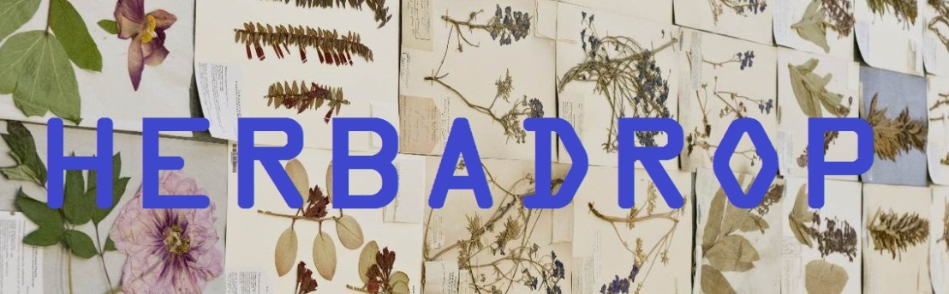
Herbadrop

Slide 2
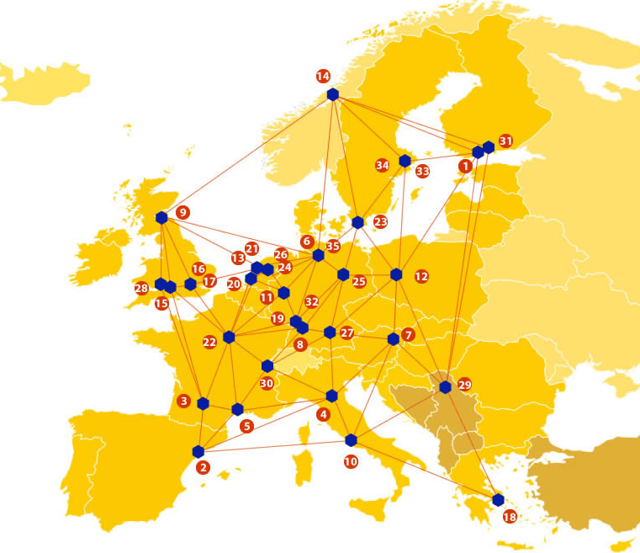

EUDAT: A truly pan-European Infrastructure
EUDAT offers common data services to both research communities and individuals through a network of 35 European organisations.
EUDAT wants to enable European researchers from any discipline to preserve, find, access, and process data in a trusted environment, as part of a Collaborative Data Infrastructure.
European infrastructures
Technology Providers
Research Communities

Slide 3

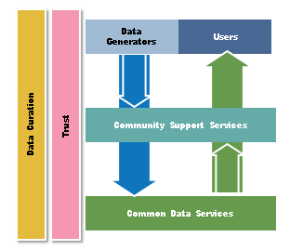
EUDAT Vision & Mission
Vision: Data is shared and preserved across borders and disciplines thereby enhancing the value and quality of research at large.
Mission: To enable data stewardship within and between European Research Communities through a Collaborative Data Infrastructure, a common model and service infrastructure for managing data spanning all European research data centres and community data repositories.

Slide 4
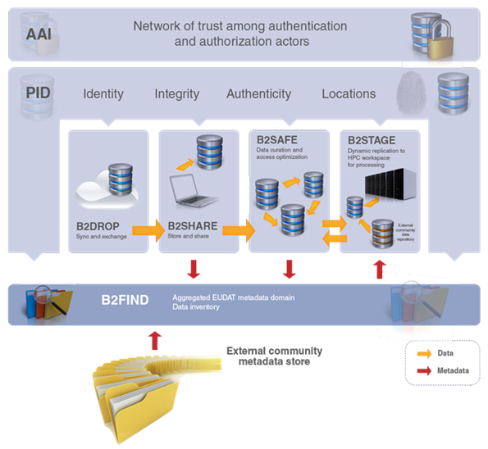














B2 Service Suite
Covering both access and deposit, from informal data sharing to long-term archiving, and addressing identification, discoverability and computability of both long-tail and big data, EUDAT services seek to address the full lifecycle of research data
https://www.eudat.eu/services
Notes:
B2FIND
stores metadata as well through other EUDAT services such as B2SHARE to provide access to data object within the EUDAT CDI
is used in inter-service use cases, e.g. to select links to data to be transferred to HPC platforms through B2STAGE

Slide 5






Building solutions with the communities
EUDAT services (B2 Service Suite) are designed, built and implemented together with user communites.
Common Language Resources and Technology Infrastructure (CLARIN)
European Network for Earth System Modelling (ENES)
Distributed infrastructure for life-science information (ELIXIR)
European Plate Observing System (EPOS) - Solid Earth sciences Research Infrastructure
Integrated Carbon Observation System (ICOS) to quantify & understand greenhouse gas balance
Long-Term Ecosystem Research (LTER) in Europe

Slide 6
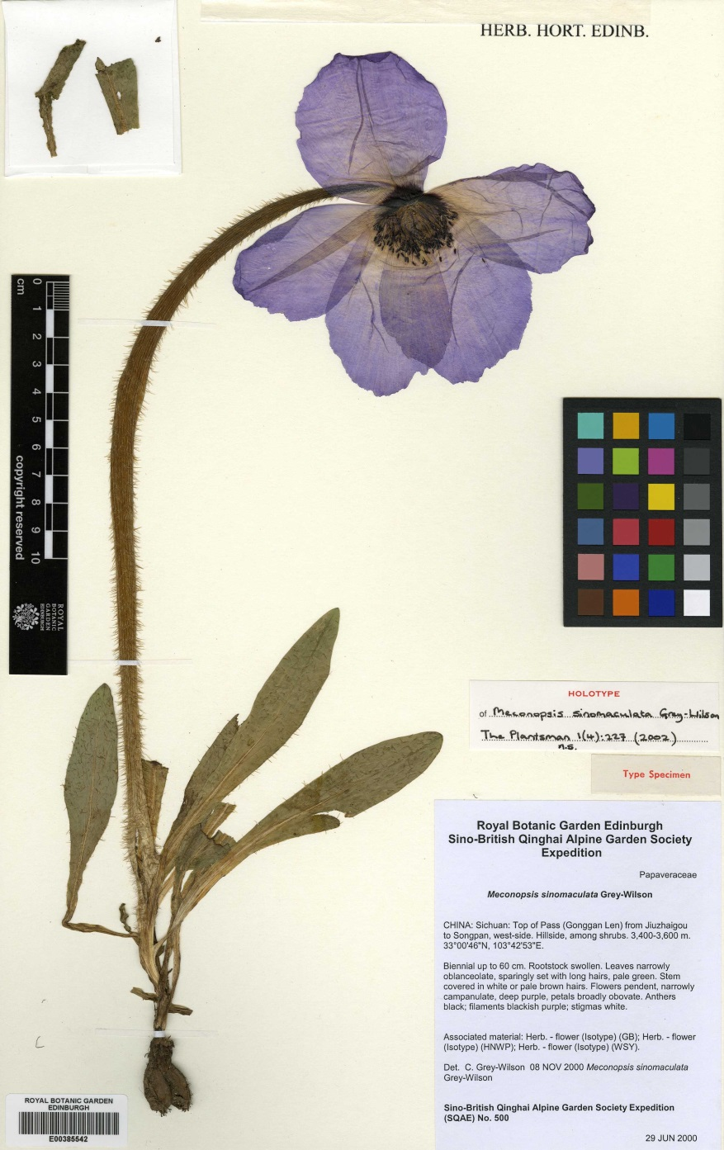
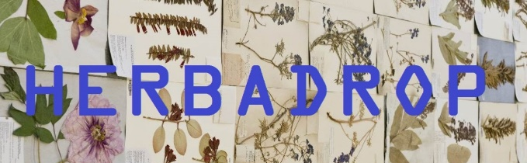
Challenges
500 million specimens in herbaria all over the world
Global trend to industrial digitizing
Data difficult to handle even for medium size institutes
Same challenges being faced by potentially hundreds of herbaria in Europe
Makes sense to work together to develop a solution
tiff: 180MB zip: 80MB jpg: 1MB
Total: 161MB
Notes:
What is the problem/scientific challenge you are addressing?
Large amount of images and related data
Images are large files, resulting in a significant storage issue for institutes holding Natural History Collections
These institutes often do not have existing ICT capacity for this digital storage, particularly for long-term preservation
There has been a prioritisation to digitise the collections but there has not been the necessary related funding in the management and long term preservation of the resulting images
These challenges are being faced by potentially hundreds of natural history collections in Europe and it therefore makes sense to work together to develop a solution
What are the potential consequences faced to your community without a solution?
There is a serious risk of losing large numbers of digital images, several institutes have already had issues which have resulted in the loss of images
The duplication of effort in finding a solution would result in wasting both time and money
The solution would open up tools to more institutes – these would generally not otherwise be available

Slide 7
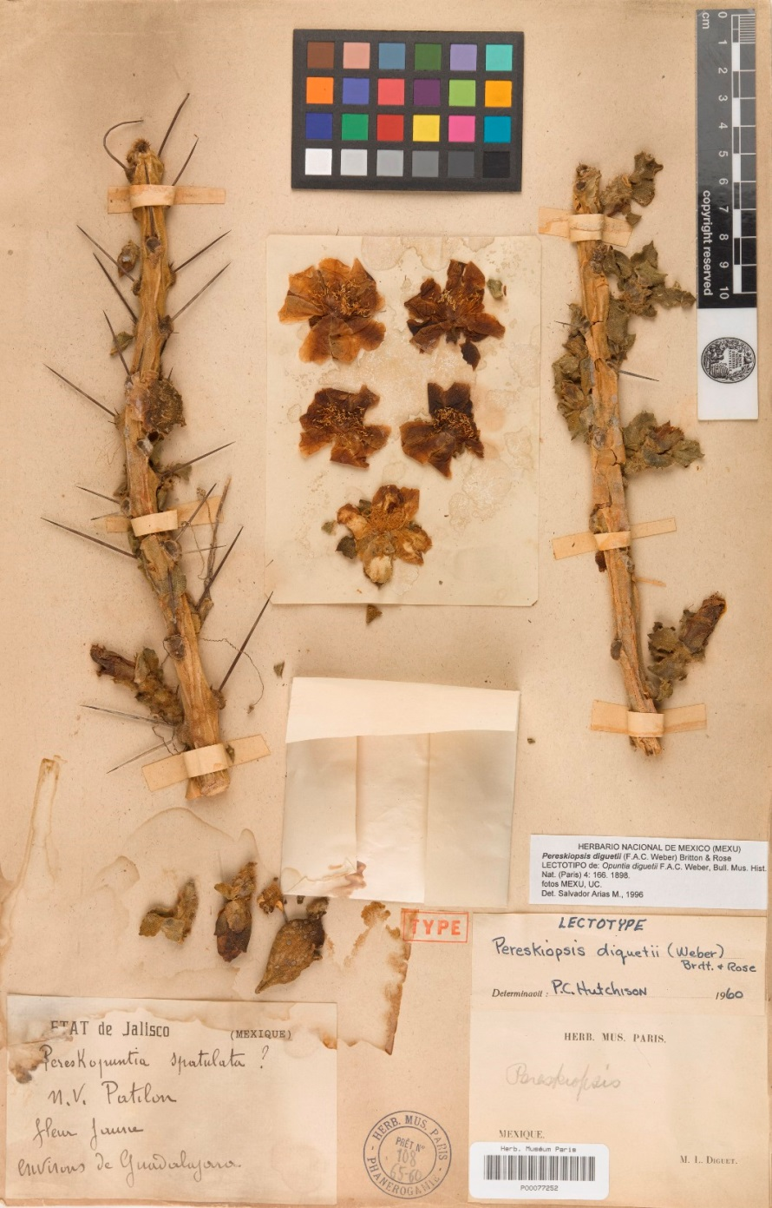
Risks
Serious risk of losing data – several institutes already had losses
Duplication of effort in finding a solution – waste of time and money
Without a solution many tools are not available to institutes resulting in inefficient progress at best
Notes:
What is the problem/scientific challenge you are addressing?
Large amount of images and related data
Images are large files, resulting in a significant storage issue for institutes holding Natural History Collections
These institutes often do not have existing ICT capacity for this digital storage, particularly for long-term preservation
There has been a prioritisation to digitise the collections but there has not been the necessary related funding in the management and long term preservation of the resulting images
These challenges are being faced by potentially hundreds of natural history collections in Europe and it therefore makes sense to work together to develop a solution
What are the potential consequences faced to your community without a solution?
There is a serious risk of losing large numbers of digital images, several institutes have already had issues which have resulted in the loss of images
The duplication of effort in finding a solution would result in wasting both time and money
The solution would open up tools to more institutes – these would generally not otherwise be available

Slide 8

The Herbadrop Data Pilot
Herbadrop is both an archival service for long-term preservation of herbarium specimen images and a tool for extracting information by image analysis.
The proposed innovative service platform is expected to support or even substitute costly manual data input activities as much as possible. The platform will also curate and complete metadata with result of image analysis such as optical character recognition (OCR) and pattern matching.
Results will be exposed as platform independent web-services which can be effectively integrated into herbarium data management systems as well as metadata capture workflows.

Slide 9






Herbadrop
Five European partners Piloting a model that could then be replicated by other institutes

Slide 10
EUDAT Service Uptake
1) B2SAFE will be used in the first step of the ingestion process. Existing images of herbarium specimens along with the associated data are transmitted to the CINES repository using a Data synchronisation & exchange service.
2) The ingestion into B2SAFE will always be carried out in accordance with the centralized persistent identifiers (PID) management system used in EUDAT (e.g. EPIC handle);
3) The discovery, sharing and visualization of the data objects can be performed with the EUDAT B2FIND service.

