Slide 1

NFFA Europe

Slide 2
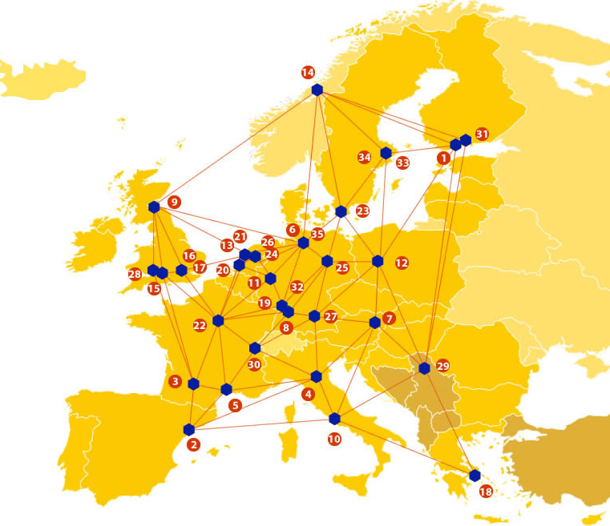

EUDAT: A truly pan-European Infrastructure
EUDAT offers common data services to both research communities and individuals through a network of 35 European organisations.
EUDAT wants to enable European researchers from any discipline to preserve, find, access, and process data in a trusted environment, as part of a Collaborative Data Infrastructure.
European infrastructures
Technology Providers
Research Communities

Slide 3

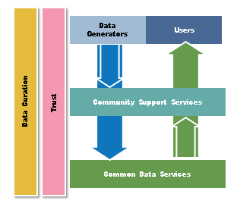
EUDAT Vision & Mission
Vision: Data is shared and preserved across borders and disciplines thereby enhancing the value and quality of research at large.
Mission: To enable data stewardship within and between European Research Communities through a Collaborative Data Infrastructure, a common model and service infrastructure for managing data spanning all European research data centres and community data repositories.

Slide 4
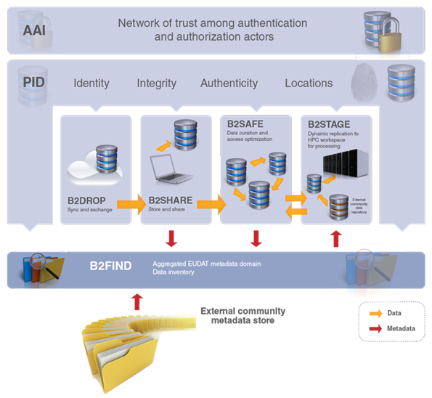














B2 Service Suite
Covering both access and deposit, from informal data sharing to long-term archiving, and addressing identification, discoverability and computability of both long-tail and big data, EUDAT services seek to address the full lifecycle of research data
https://www.eudat.eu/services
Notes:
B2FIND
stores metadata as well through other EUDAT services such as B2SHARE to provide access to data object within the EUDAT CDI
is used in inter-service use cases, e.g. to select links to data to be transferred to HPC platforms through B2STAGE

Slide 5






Building solutions with the communities
EUDAT services (B2 Service Suite) are designed, built and implemented together with user communites.
Common Language Resources and Technology Infrastructure (CLARIN)
European Network for Earth System Modelling (ENES)
Distributed infrastructure for life-science information (ELIXIR)
European Plate Observing System (EPOS) - Solid Earth sciences Research Infrastructure
Integrated Carbon Observation System (ICOS) to quantify & understand greenhouse gas balance
Long-Term Ecosystem Research (LTER) in Europe

Slide 6

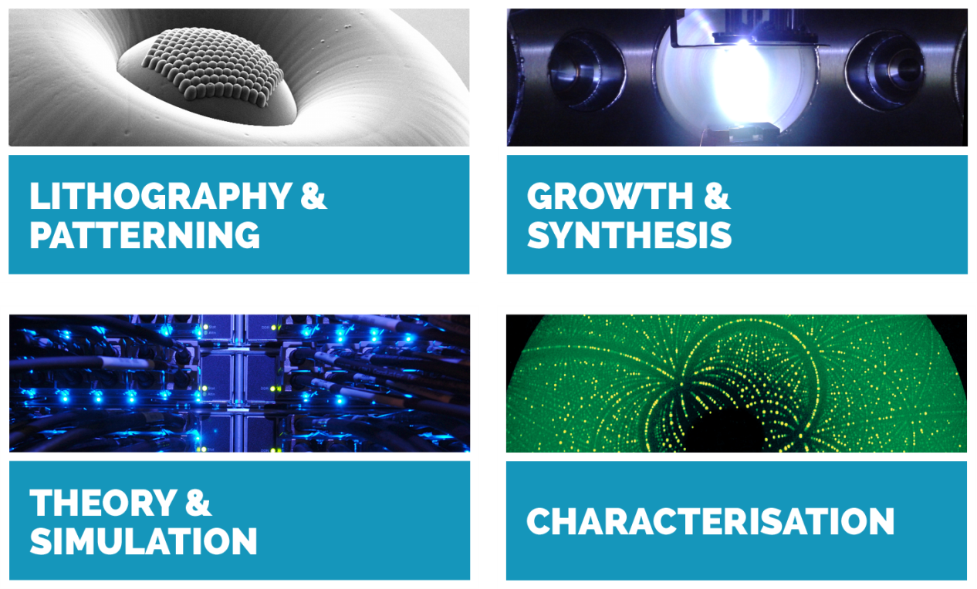
the NFFA-EUROPE project
A distribute facility to provide access to nanoscience facilities
Regulated access to state of the art nanoscience facilities integrated with the large scale infrastructures for fine analysis

Slide 7
The NFFA-EUROPE
Data Challenge
Create the first nano-science Information and Data management Repository Platform (IDRP)
Key points:
  Incorporate/leverage on existing standards, recommendations and evolving best practices of data management
  Usage of existing e-infrastructures favoured rather than building own e-infrastructure for from scratch.
There is a need for the integrated Information and to cover the full research lifecycle for the user community.

Slide 8
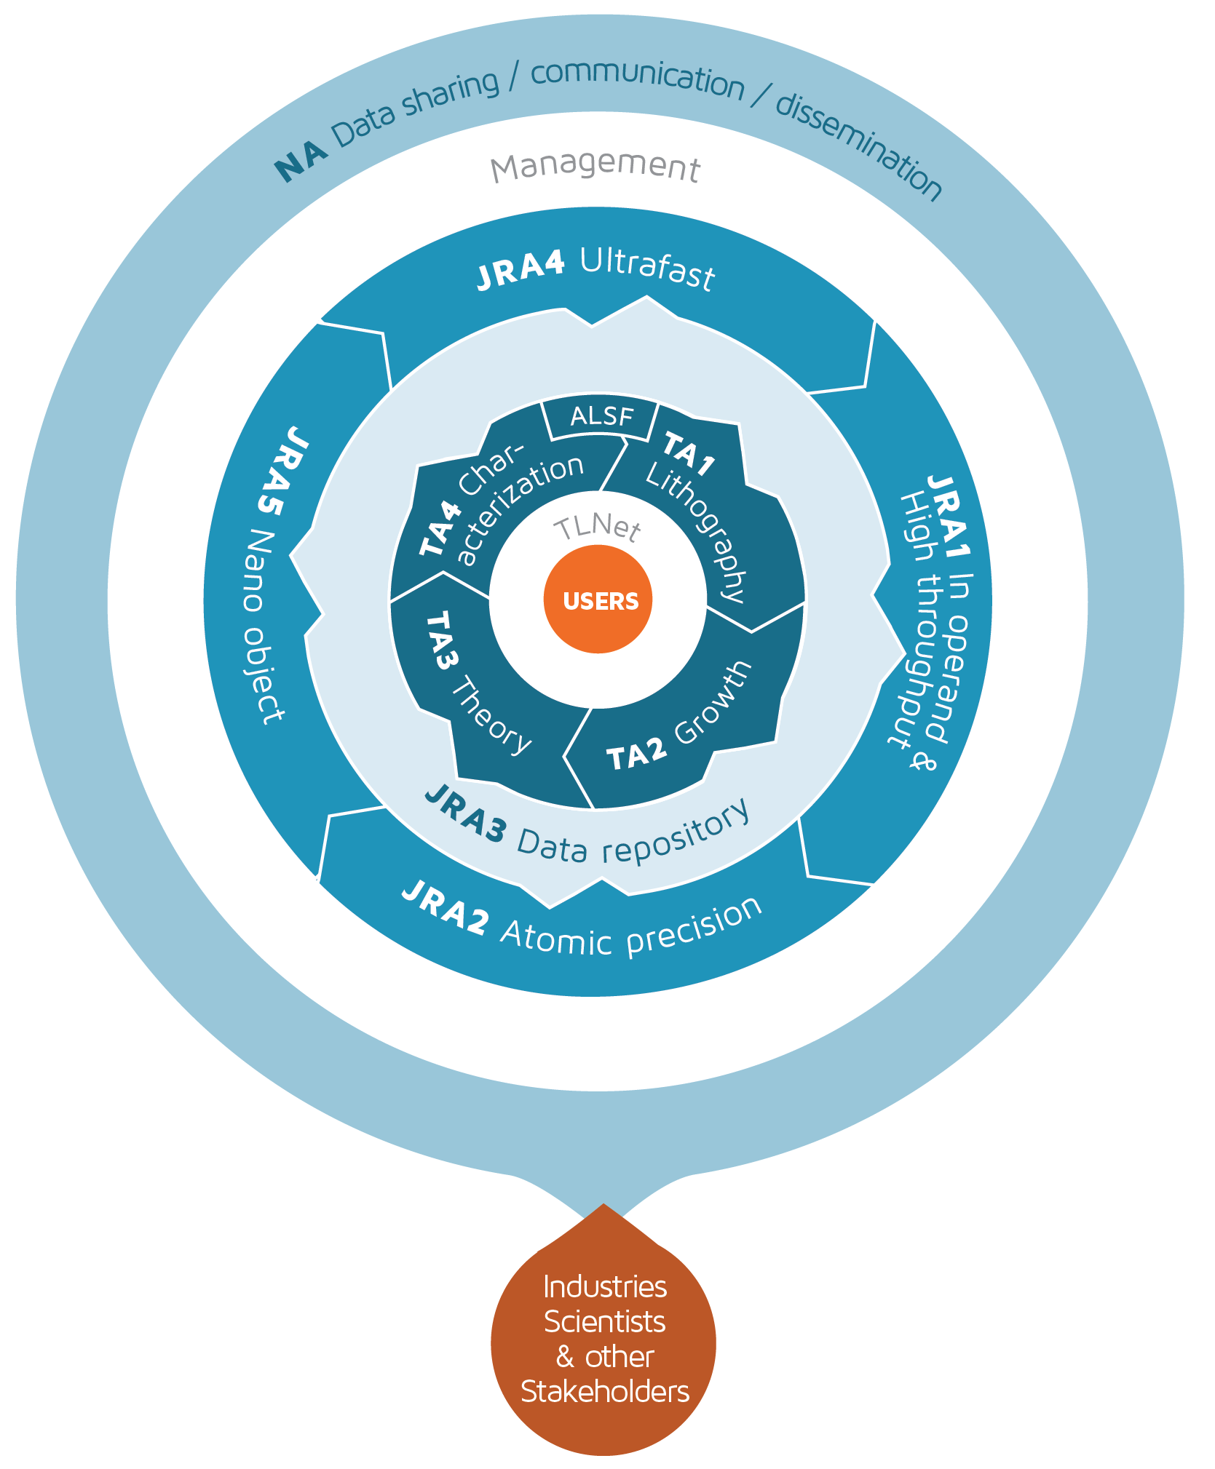
IDRP Overview
IDPR is a JRA within NFFA-EUROPE EU project
It offers a common data infrastructure for all the TA users of the NFFA-EUROPE infrastructure.
Features:
  Seamless integration into data/measurement workflows and available infrastructures
  Simplified data retrieval by comprehensive use of metadata
  Possibility to share and to publish datasets

Slide 9
EUDAT Service Uptake
Repository for shareable digital objects - Support sharing of long tail experimental data
Multi-disciplinary joint metadata catalogue - Provide easy and flexible discovery of data in a central location
Data replication and long term preservation Explore opportunities for scalable and trusted storage and replication of raw experimental data

Slide 10

Contact
EUDAT
Web – eudat.eu
Twitter - @EUDAT_EU
Stefano Cozzini
JRA3 leader
CNR-IOM Italy
Stefano.cozzini@iom.cnr.it

