Slide 1

Public access to fine-grained city air quality data from roving sensors
& EUDAT Collaboration

Slide 2
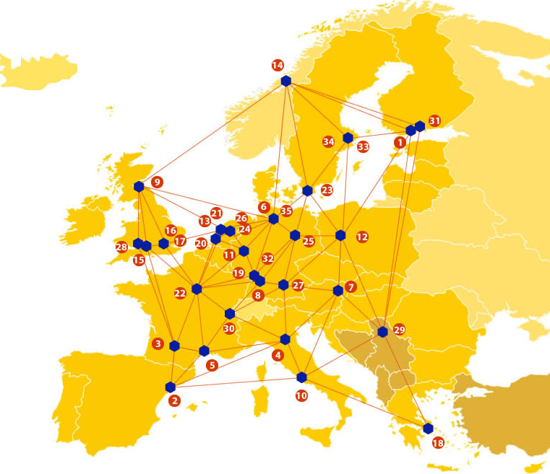

EUDAT: A truly pan-European Infrastructure
EUDAT offers common data services to both research communities and individuals through a network of 35 European organisations.
EUDAT wants to enable European researchers from any discipline to preserve, find, access, and process data in a trusted environment, as part of a Collaborative Data Infrastructure.
European infrastructures
Technology Providers
Research Communities

Slide 3

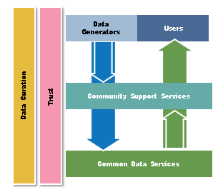
EUDAT Vision & Mission
Vision: Data is shared and preserved across borders and disciplines thereby enhancing the value and quality of research at large.
Mission: To enable data stewardship within and between European Research Communities through a Collaborative Data Infrastructure, a common model and service infrastructure for managing data spanning all European research data centres and community data repositories.

Slide 4
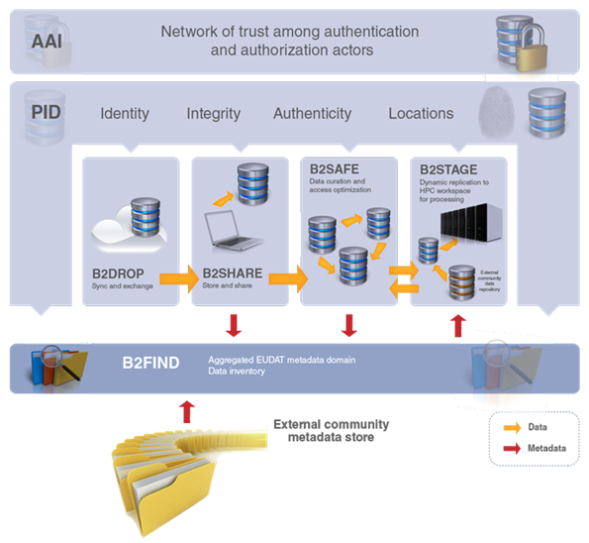














B2 Service Suite
Covering both access and deposit, from informal data sharing to long-term archiving, and addressing identification, discoverability and computability of both long-tail and big data, EUDAT services seek to address the full lifecycle of research data
https://www.eudat.eu/services
Notes:
B2FIND
stores metadata as well through other EUDAT services such as B2SHARE to provide access to data object within the EUDAT CDI
is used in inter-service use cases, e.g. to select links to data to be transferred to HPC platforms through B2STAGE

Slide 5






Building solutions with the communities
EUDAT services (B2 Service Suite) are designed, built and implemented together with user communities.
Common Language Resources and Technology Infrastructure (CLARIN)
European Network for Earth System Modelling (ENES)
Distributed infrastructure for life-science information (ELIXIR)
European Plate Observing System (EPOS) - Solid Earth sciences Research Infrastructure
Integrated Carbon Observation System (ICOS) to quantify & understand greenhouse gas balance
Long-Term Ecosystem Research (LTER) in Europe

Slide 6
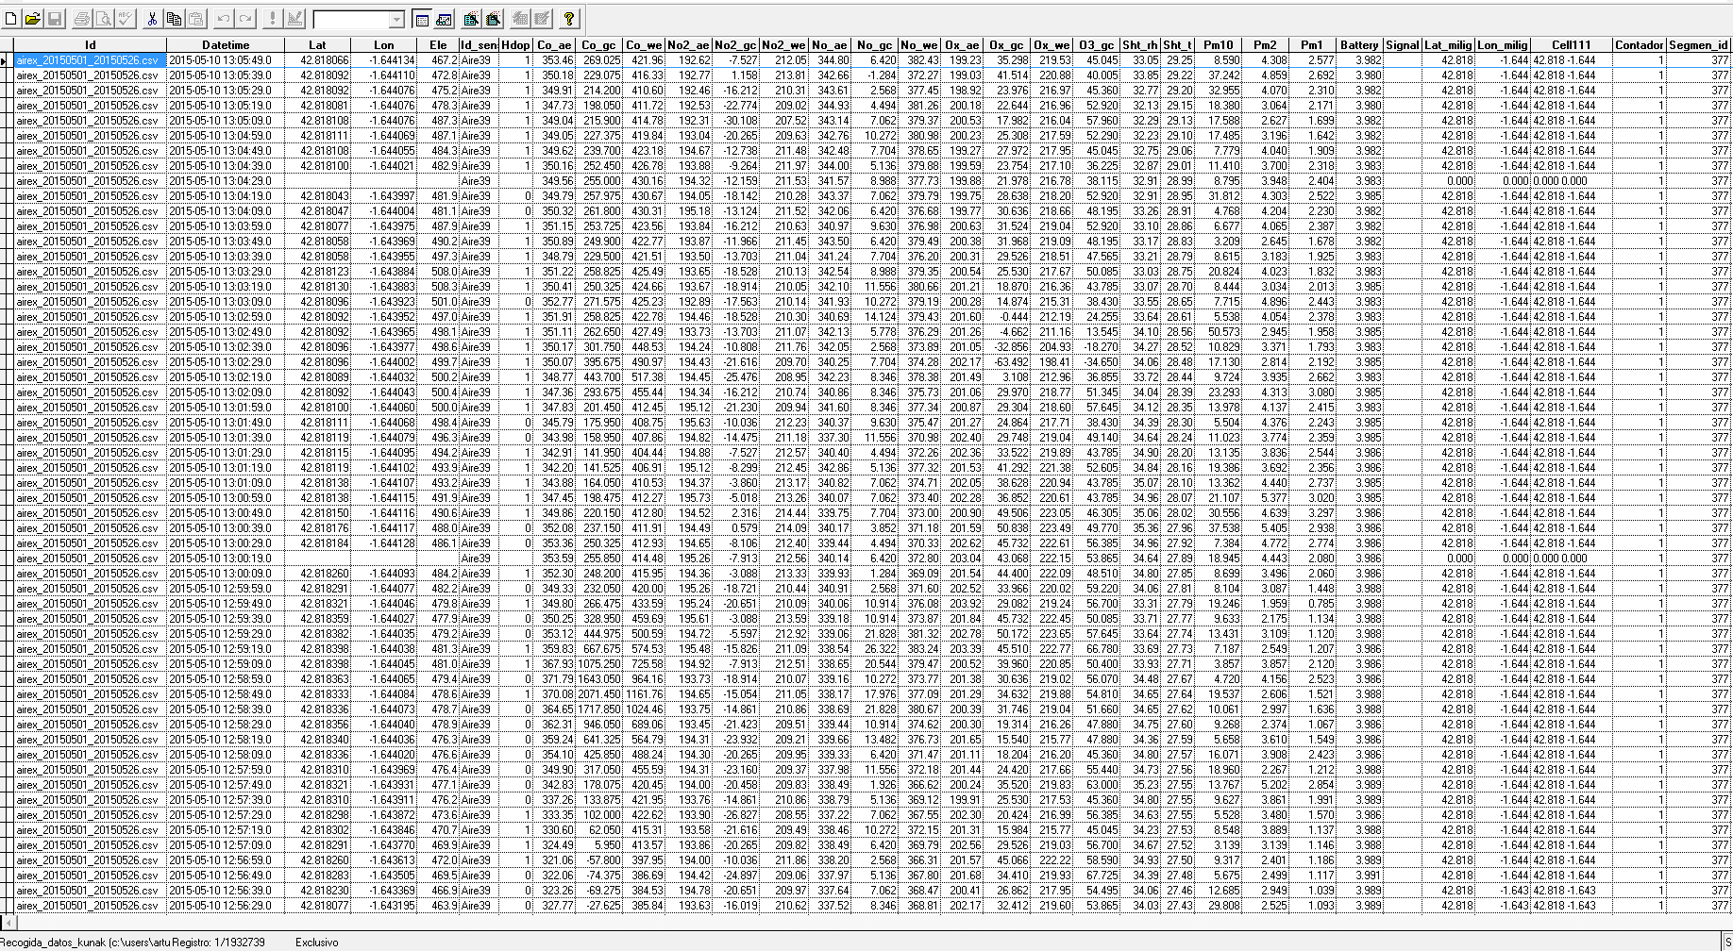
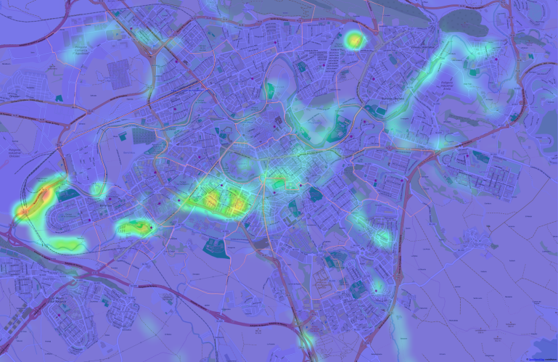
The Challenge
LIFE+RESPIRA produces gas pollution data at high rates that need ready access and storage.
Thus we need to build and store a continuously-updated, multi-million-record dataset.
The challenge is how to ensure a dataflow that allows public access to raw and processed data.

Slide 7
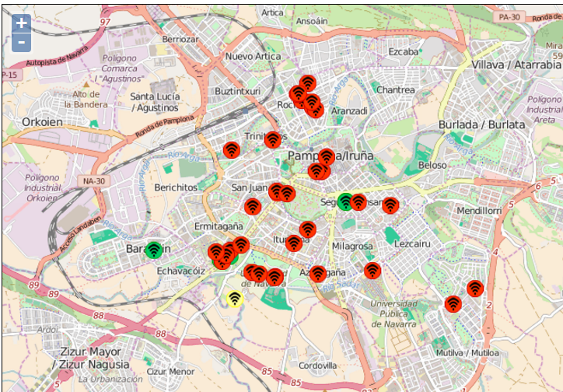
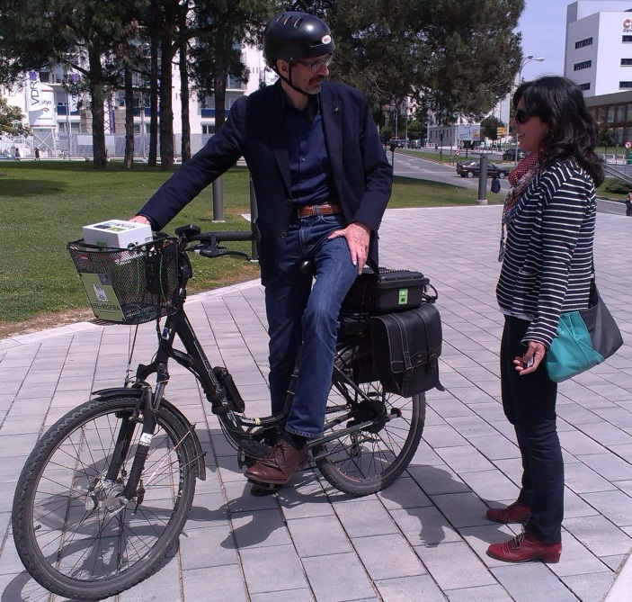
Pilot Overview
The project LIFE+RESPIRA has a network of 50 autonomous, multiparametric air pollution sensors carried around by volunteer cyclists in Pamplona, Spain.
Contaminant gasses and particles are recorded at very fine spatial and temporal resolution (few meters, seconds), and transmitted in near-real time for processing. A huge volume of data is being produced and, after heavy processing, serves to feed an air quality model that use climate, traffic and topographic data allowing prediction of best routes for city dwellers.
The pilot wants to ensure that citizens and researchers alike can fully access the pre- and post-processed data for any scientific, social, or policy purpose.

Slide 8
EUDAT Service Uptake
Repository for shareable digital objects
Data replication and long term preservation
Either B2SHARE or B2SAFE, according to the scale of the dataset, would be preferred to store a copy of both the raw data and the results to be disseminated among the interested public: researchers and citizen researchers wanting to access the raw or processed data. Thus, either B2SHARE or B2SAFE would act as final, permanent, post-project repositories of the project’s data, and could become the primary repositories for any project extension.
Secure and trusted cloud storage - B2DROP will substitute, at an advantage, our current sharing of the main repository so all teams access the latest updates

Slide 9

Contact
Arturo H. Ariño
University of Navarra, Spain
artarip@unav.es
EUDAT
Web – eudat.eu
Twitter - @EUDAT_EU

