Slide 1

West-Life

Slide 2
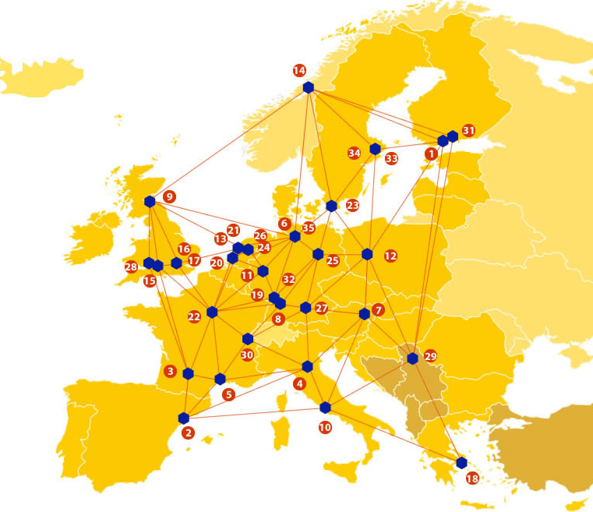

EUDAT: A truly pan-European Infrastructure
EUDAT offers common data services to both research communities and individuals through a network of 35 European organisations.
EUDAT wants to enable European researchers from any discipline to preserve, find, access, and process data in a trusted environment, as part of a Collaborative Data Infrastructure.
European infrastructures
Technology Providers
Research Communities

Slide 3

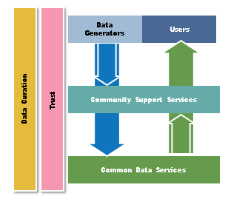
EUDAT Vision & Mission
Vision: Data is shared and preserved across borders and disciplines thereby enhancing the value and quality of research at large.
Mission: To enable data stewardship within and between European Research Communities through a Collaborative Data Infrastructure, a common model and service infrastructure for managing data spanning all European research data centres and community data repositories.

Slide 4
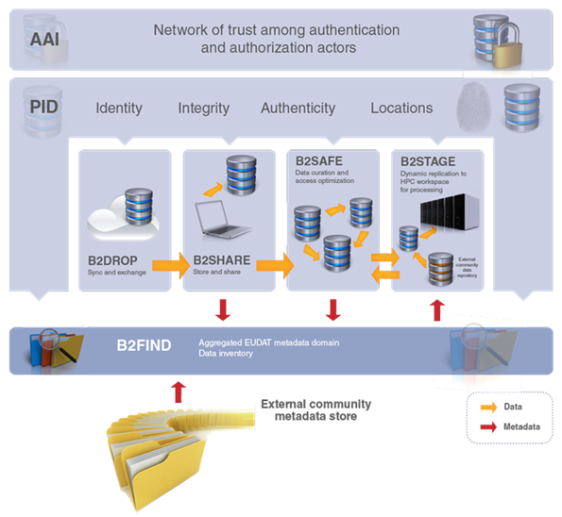














B2 Service Suite
Covering both access and deposit, from informal data sharing to long-term archiving, and addressing identification, discoverability and computability of both long-tail and big data, EUDAT services seek to address the full lifecycle of research data
https://www.eudat.eu/services
Notes:
B2FIND
stores metadata as well through other EUDAT services such as B2SHARE to provide access to data object within the EUDAT CDI
is used in inter-service use cases, e.g. to select links to data to be transferred to HPC platforms through B2STAGE

Slide 5






Building solutions with the communities
EUDAT services (B2 Service Suite) are designed, built and implemented together with user communites.
Common Language Resources and Technology Infrastructure (CLARIN)
European Network for Earth System Modelling (ENES)
Distributed infrastructure for life-science information (ELIXIR)
European Plate Observing System (EPOS) - Solid Earth sciences Research Infrastructure
Integrated Carbon Observation System (ICOS) to quantify & understand greenhouse gas balance
Long-Term Ecosystem Research (LTER) in Europe

Slide 6

The Challenges within the
Structural Biology field
73% working on eukaryotic rather than prokaryotic systems
84% working on complexes rather than single gene products
Each research team routinely uses three-four different techniques
83% would use combined SB techniques more often if it was easier to get access to experimental facilities
73% of the cases found it hard to combine software tools for different techniques in integrated workflows
  Combined techniques
    not always acting as an expert
Small samples
Data noisy and incomplete
Deliver results to other life scientists

Slide 7










West-Life Pilot: the partners
10 Partners:
    STFC (UK) (lead partner, Martyn Winn Coordinator)
    Dutch Cancer Institute (NKI) (NL)
    EMBL (DE)
    Masaryk University (MU) (CZ)
    Consejo Superior De Investigaciones Cientificas (CSIC) (ES)
    Consorzio Interuniversitario Risonanze Magnetiche Di Metallo Proteine (CIRMPP) (IT)
    INSTRUCT (UK)
    Utrecht University (NL)
    Luna (FR) – (SME)
    INFN (IT)
Budget: €4 000 0000
Duration: 36 months
Started: 1 Nov 2015
Proposal ID 675858

Slide 8
West-Life Pilot
West-Life will provide a Virtual Research Environment for structural biologists across Europe.
Users will range from PhD students to professors.
The raw data will be acquired at experimental facilities, and then a series of processing steps will create new data files, leading to the final PDB file.
Larger experimental facilities already have arrangements for storing data. Smaller facilities will benefit from being able to use EUDAT services.

Slide 9
EUDAT service uptake
The West-Life Pilot will rely on the following EUDAT services:
  B2DROP for WebDAV
  B2ACCESS: integrate with Instruct AAI
  B2SHARE, when it supports WebDAV
  B2NOTE, including PROV-O support
  (If required) B2STAGE for performant transfer of large datasets

Slide 10

For additional information
http://www.eudat.eu/
Chris Morris, STFC, UK
chris.morris@stfc.ac.uk

