Slide 1





NOMAD
Novel Materials Discovery
Raphael Ritz
Head of Data Division
Max Planck Computing and Data Facility

Slide 2
Agenda
Background and Motivation: Materials Science
The NoMaD Repository
The NOMAD Laboratory
Questions to EUDAT

Slide 3
It‘s all about materials ...
Harder, tougher, ...
Light-weight, ductile, ...
Flexible, ultra-thin, ...
Non-toxic, sustainable, edible, ...
Energy saving, ...
Composites, bio-inspired, nano, ...
Goal: gain insight and understanding

Slide 4
How big is the pool of materials?
200,000 inorganic materials are known to exist.
Their properties with respect to a specific application are largely unexplored.
Considering surfaces, interfaces, defect structures, organic materials, and hybrid systems, the number of materials is practically without limits.
Imagine their behavior under extreme conditions.
It is clear that the conventional route of synthesis and characterization is not the most efficient.
This is where theory comes into play …

Slide 5
Computational Materials Data
High-throughput screening has become a new area of materials research.
The amount of materials data produced on workstations, compute clusters, and supercomputers is growing exponentially.
Though containing a lot of valuable information, most of the data are thrown away …

Slide 6
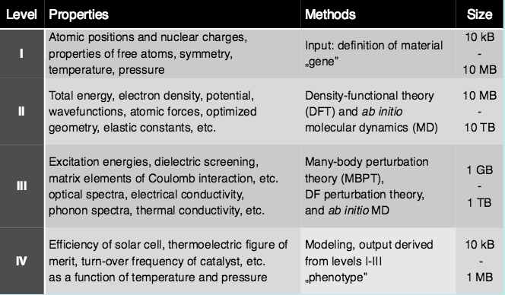
Computational Materials Data

Slide 7
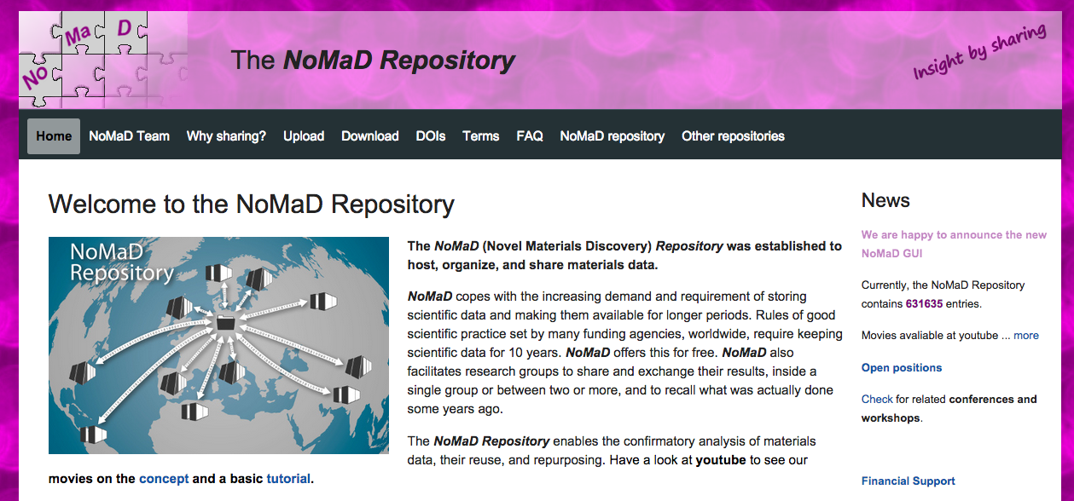
Novel Materials Discovery
http://nomad-repository.eu/
PIs: Claudia Draxl (HU Berlin) and Matthias Scheffler (Fritz-Haber-Institute, Berlin)
Notes:
The repository was made to host, organize and share materials data

Slide 8
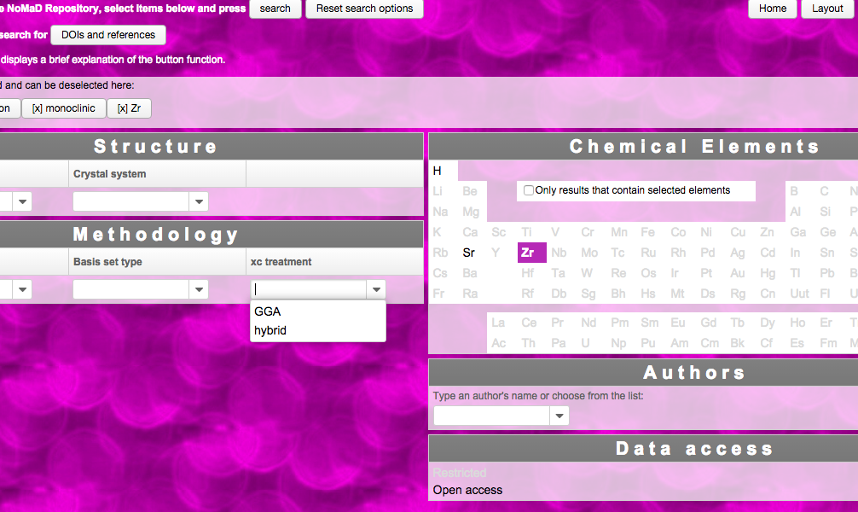
NoMaD Repository – Search Interface
http://nomad-repository.eu:8080/NomadRepository-1.1/search/index.zul

Slide 9
NoMaD Repository – some aspects
Highly specialized community cite
Data integration requires expert knowledge
High availability and good performance expected
Complex software stack – but Open Source
Supports DOIs for data sets
Basis of the H2020 CoE NOMAD Laboratory
ca. 15 TB raw data – 2 Mio “calculations”

Slide 10
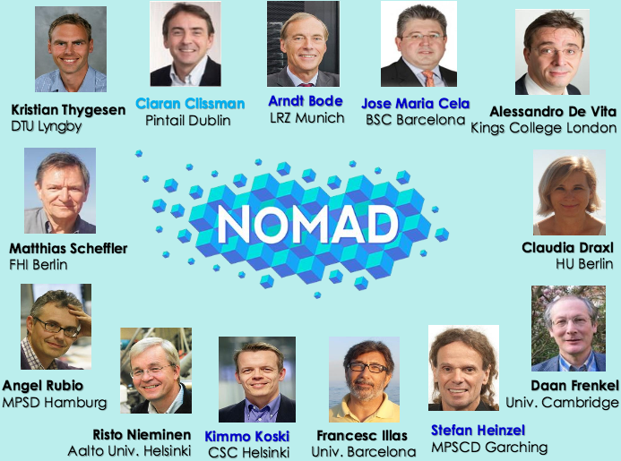
NOMAD Laboratory

Slide 11
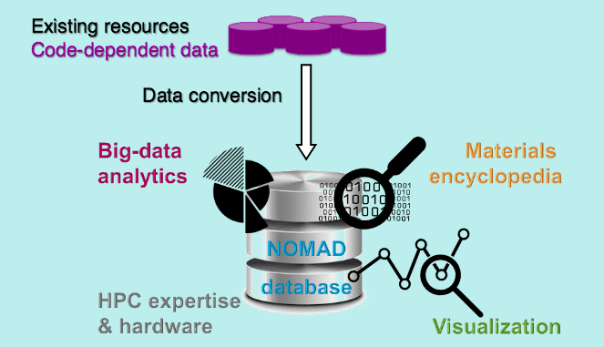
NOMAD Laboratory

Slide 12
Questions to EUDAT
Mirror the repository to CSC and BSC (B2Safe?)
  Beware of the application on top of the data
Help with certification (DSA)
B2Drop as interface for uploads?
DOIs versus B2Handle?
Generic authentication (B2Access?)
Make data accessible at various compute sites (B2Stage?)
Improve the findability of content (B2Find?)
Semantic annotation (B2Note?)
Establish a Data Type Registry for materials data?

Slide 13
Thank you!
Questions?
http://nomad-repository.eu
http://nomad-coe.eu

